Slide 1
Correlation

Slide 2
Correlation
Correlation: Are two variables related?
Examples: Exercise and Health, Study and Marks, Experience and Salary
Measured using correlation coefficient (r)
Pearson Correlation Coefficient: Measures linear relationships between continuous variables
Spearman Rank Correlation Coefficient: Measures relationships, even if they are not strictly linear

Slide 3
Correlation Interpretation
Range is -1 to +1
Positive correlation: Variables move up together
Example: Correlation of 0.80 between Hours spent studying and test scores
Negative correlation: As one variable moves up, the other moves down
Example: Correlation of -0.70 between Hours spent watching TV and physical fitness
Zero correlation: Variables are unrelated
Example: Correlation of 0.02 between Shoe size and IQ score

Slide 4
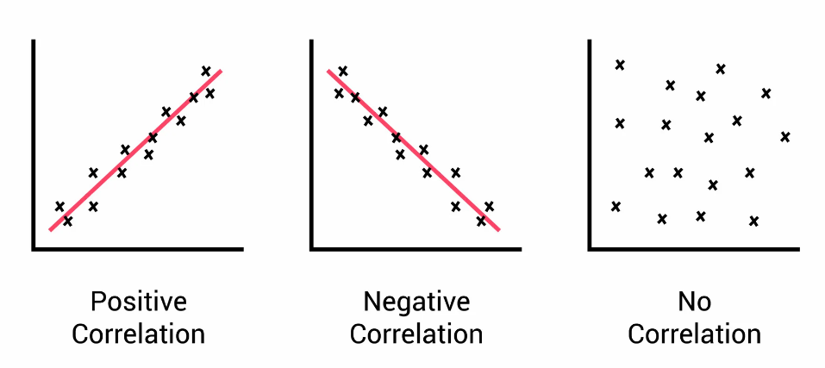
Positive, Negative, No Correlation

Slide 5
Key Point about Correlation
Plotting the correlation between two completely different variables, such as age and income, may not provide meaningful insights because correlation is typically used to measure the strength and direction of the linear relationship between two continuous variables
In the case of age and income, these variables serve different purposes, their scales are different (Years, Dollars) and may not have a straightforward linear relationship
But if we plot correlation between say Marks in Science and Marks in Maths, it makes a lot of sense, because we are talking about a similar scale and purpose
(See C:\code\Data Analytics\correlation-outliers-bad-example.py later)

Slide 6
Correlation Examples
C:\code\Data Analytics\correlation.py
C:\code\Data Analytics\correlation-2.py
C:\code\Data Analytics\implementation\6_correlation.py
C:\code\Data Analytics\correlation-outliers.py
C:\code\Data Analytics\correlation-outliers-dataset.py
C:\code\Data Analytics\correlation-outliers-bad-example.py

Slide 7
Covariance

Slide 8
Covariance
Covariance quantifies how changes in one variable relate to changes in another
Scale of covariance is in the units of what we are measuring (difficult to interpret), whereas correlation is always between -1 and +1 (easy)
Useful when units of measurement and scale are important
Example: Are temperature and rainfall related?
Correlation: Will give a value between -1 and +1, say 0.5 (Says Moderate)
Covariance: For every 1 degree increase in temperature, rainfall decreases by 5 mm (Says How much?)

Slide 9
Covariance Examples
C:\code\Data Analytics\implementation\7_covariance.py
C:\code\Data Analytics\implementation\7_covariance_2.py

Slide 10
Descriptive versus Predictive Modelling versus Prescriptive Modelling
Descriptive modelling/statistics: Summarize and describe data
Examples: Mean, Mode, Median, Standard deviation, Range, Frequency distribution
Predictive modelling/statistics: Use data to make future predictions
Examples: Linear/logistic regression, Time series analysis, Decision trees, Machine learning algorithms
Prescriptive modelling/statistics: Use data and models to make most optimum decisions and recommendations
Examples: Linear programming, Decision trees, Game theory

Slide 11
Predictive Modelling

Slide 12
Predictive Modelling
Predictive modeling uses statistics and modeling techniques to make predictions about future outcomes
Looks at current and historical data patterns to see if the patterns are likely to emerge again
Generally classified into regression and classification (See next slide)
Common types: Linear regression, Logistic regression, Decision trees, Random forest, Neural networks, Time series forecasting, K Nearest Neighbors (KNN), Naïve Bayes, Clustering

Slide 13
Regression and Classification
Regression has a numeric target
Classification has a class target
Regression examples | Classification examples
How many page views will we get? | Is this a fraudulent transaction?
What will be the amount of loss? | Whose face is in this picture?
What will be the blood sugar level? | Which product is best fit for the customer?

Slide 14
Regression Analysis

Slide 15
Regression
Goal of regression is to predict a dependent variable using independent variable(s)
Y: Dependent numeric variable, also called predicted/output/target variable
X: Independent variable(s), also called predictor/feature/explanatory/covariate
Given X, we want to find Y
Generally, Y is numeric
When Y is True/False type, it is logistic regression (See next slide)

Slide 16
Main Types of Regression
Linear Regression: Used when the relationship between the independent variable and the dependent variable is assumed to be linear (goal is to fit a straight line to the data)
Multiple Regression: Extends linear regression to include more than one independent variable (i.e. multiple predictors that may influence the dependent variable) – Also called multivariate analysis
Logistic Regression: Used for binary classification problems (e.g., yes/no, 1/0)

Slide 17
Examples of Regression
Linear Regression: Predicting House Prices
Independent Variable: Area of the House (Continuous)
Dependent Variable: House Price (Continuous)
Multiple Regression: Predicting Salary Based on Experience and Education
Independent Variables: Years of Experience (Continuous), Level of Education (Categorical: Bachelor's, Master's, PhD)
Dependent Variable: Salary (Continuous)
Logistic Regression: Predicting Customer Churn
Independent Variables: Customer Tenure (Continuous), Monthly Subscription Cost (Continuous), Customer Complaints (Count)
Dependent Variable: Churn (Binary: Yes or No)

Slide 18
Regression Code Examples
C:\code\Data Analytics\implementation\12_linear_regression.py
C:\code\Data Analytics\implementation\12_5_multiple_linear_regression.py
C:\code\Data Analytics\implementation\logistic_regression.py
C:\code\Data Analytics\implementation\logistic_regression_2.py

Slide 19
Decision Trees

Slide 20
Decision Tree Concept
Decision tree is a flowchart for classification and regression (Hence: Classification And Regression Tree – CART)
Falls under supervised machine learning
Classification example
Check email is spam/not
Root node of the tree checks if the email contains the word free
If yes, follow branch Spam, else follow a different branch Not spam
Further nodes will check features such as sender’s address etc
Regression example
Predict house price
Root node will check area (<= 1500 square feet or not)
If yes, follow Lower price branch, else follow Higher price branch
Further nodes will check features such as number of bedrooms etc

Slide 21
Decision Tree Terminology
Decision tree induction, also known Decision tree learning is used for classification and regression tasks - Supervised learning method that builds a tree-like structure to make predictions or decisions based on input data
Supervised segmentation refers to a computer vision or image processing task where an algorithm is trained to segment or divide an image into different regions or objects based on labeled training data

Slide 22
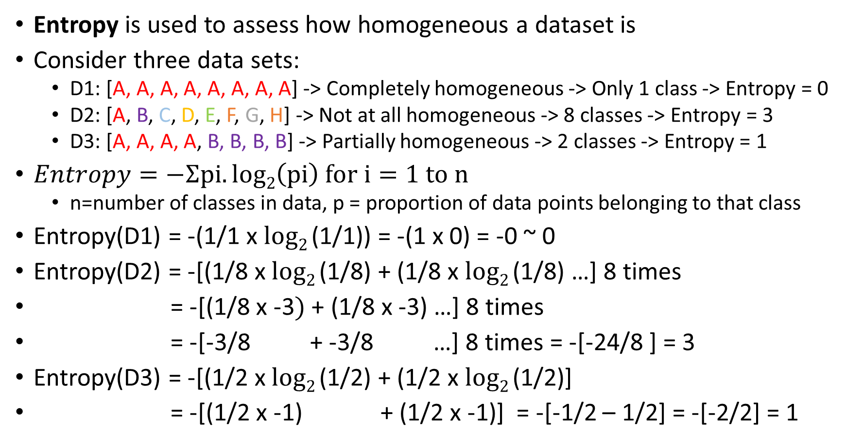
Entropy
Entropy is used to assess how homogeneous a dataset is
Consider three data sets:
D1: [A, A, A, A, A, A, A, A] -> Completely homogeneous -> Only 1 class -> Entropy = 0
D2: [A, B, C, D, E, F, G, H] -> Not at all homogeneous -> 8 classes -> Entropy = 3
D3: [A, A, A, A, B, B, B, B] -> Partially homogeneous -> 2 classes -> Entropy = 1
$Entropy=−Ʃpi.log2\left(pi\right) for i=1 to n$
n=number of classes in data, p = proportion of data points belonging to that class
Entropy(D1) = -(1/1 x $log2$(1/1)) = -(1 x 0) = -0 ~ 0
Entropy(D2) = -[(1/8 x $log2$(1/8) + (1/8 x $log2$(1/8) …] 8 times
= -[(1/8 x -3$)$ + (1/8 x -3) …] 8 times
= -[-3/8 + -3/8 …] 8 times = -[-24/8 ] = 3
Entropy(D3) = -[(1/2 x $log2$(1/2) + (1/2 x $log2$(1/2)]
= -[(1/2 x -1) + (1/2 x -1)] = -[-1/2 – 1/2] = -[-2/2] = 1

Slide 23
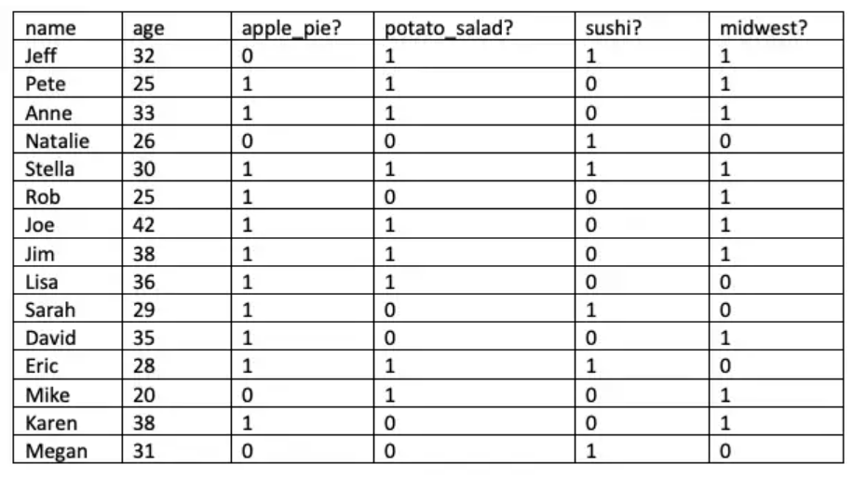
Entropy Example
Consider this dataset and calculate entropy for apple_pie? column

Slide 24
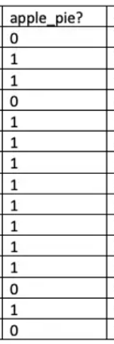

Entropy of Apple Pie? Column
Apple Pie? Yes = 11, No = 4
$Entropy=−Ʃpi.log2\left(pi\right) for i=1 to n$
=-[(11/15 x log₂(11/15) + (4/15 x log₂(4/15)]
=-[-.32 + -.50]
=-[-.82]
= 0.82

Slide 25
Entropy and Decision Trees
Suppose we are building a decision tree to predict whether a loan given to a person would result in a write-off or not
Features (Independent variables): Balance (< 50k or > 50k) and Residence (Own, Rented, Other)
Target variable: Write-off or No write-off
Current dataset has 30 records: 16 write-offs, 14 non-write-offs

Slide 26
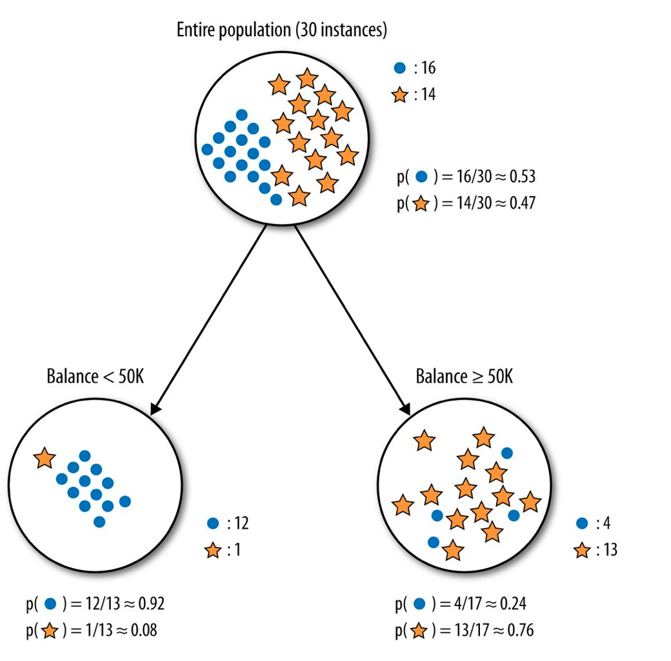
Decision Tree using Balance as the Split
Dots: Right-off, Stars: Non-write-offs
We first split the tree on Balance
Left node: 13 records
Write offs = 12 (Probability = 12/13 = 0.92)
Non-write-offs: 1 (Probability = 1/13 = 0.08)
Right node: 17 records
Write-offs: 4 (Probability = 4/17 = 0.24)
Non-write-offs: 13 (Probability = 13/17 = 0.76)

Slide 27
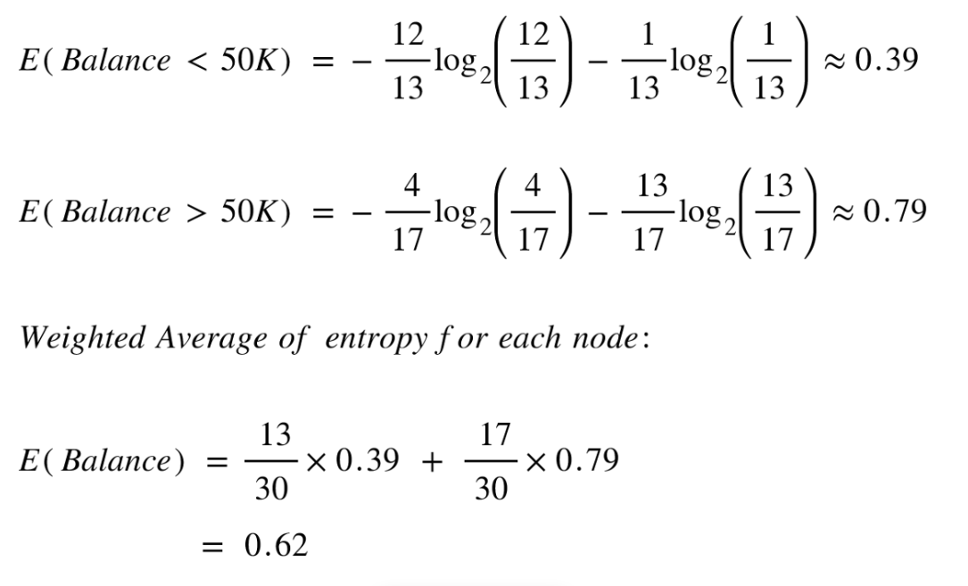
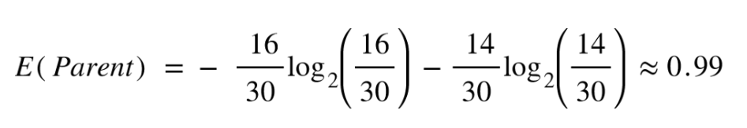
Entropy for the Parent and then After Splitting on the Balance Column

Slide 28
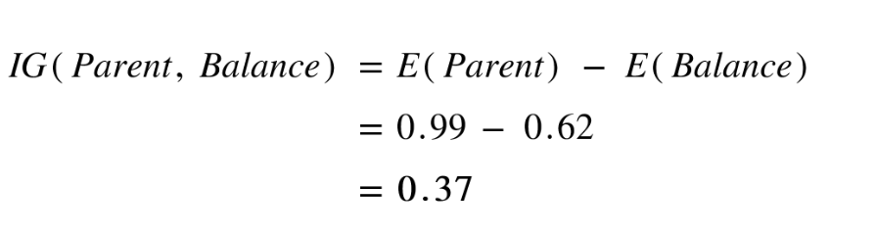
Information Gain
Information gain is the difference in entropy before and after a split in a decision tree
Conclusion: Splitting on feature ,“Balance” leads to an information gain of 0.37 on our target variable. Let’s do the same thing for feature, “Residence” to see how it compares.

Slide 29
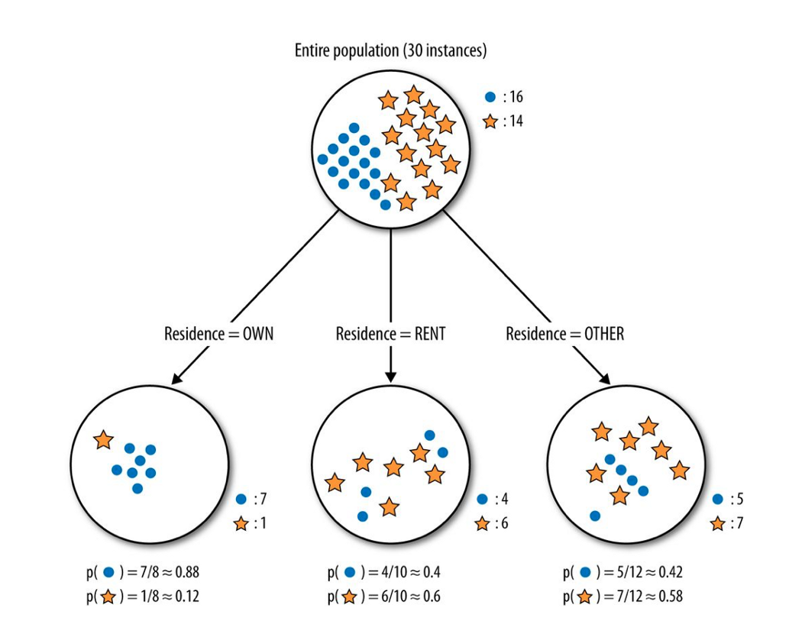
What if we split the Tree on Residence?
Splitting the tree on Residence gives us 3 child nodes.
Left child node: 8 nodes
Write-off: 7/8 (Probability 0.88)
Non-write-off: 1/8 (Probability 0.12)
Middle child nodes: 10 nodes
Write-off: 4/10 (Probability 0.40)
Non-write-off: 6/8 (Probability 0.60)
Right child node: 12 nodes
Write-off: 5/12 (Probability 0.42)
Non-write-off: 7/12 (Probability 0.58)

Slide 30
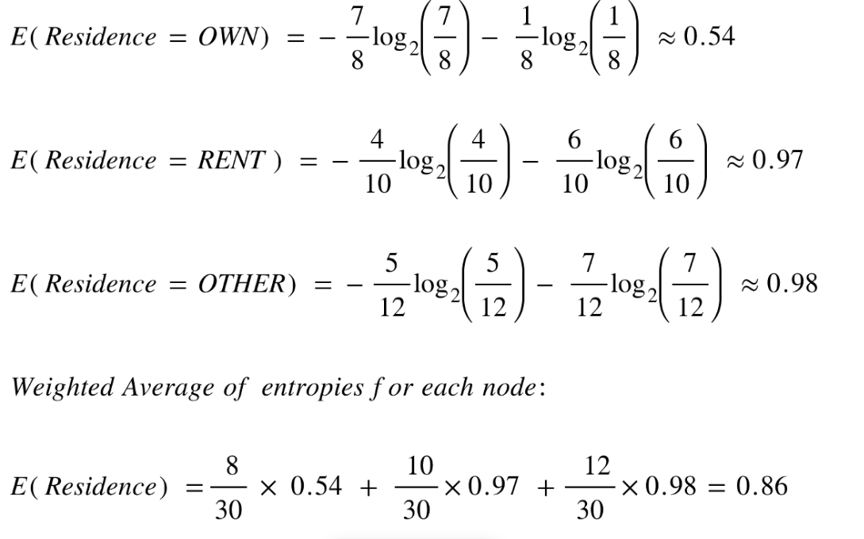
Entropy After Splitting on the Residence Column

Slide 31
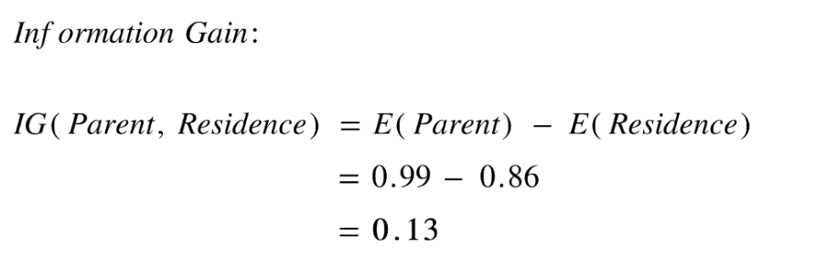
Information Gain if Split is on the Residence Column

Slide 32
Conclusion
Information Gain if split on Balance = 0.37
Information Gain if split on Residence = 0.13
Balance predicts our target variable better than residence
First split of the tree should happen on Balance

